Slide 1


Improving Diversified Pricing Strategy
with Machine Learning
INTEGRATED PROJECT | SUMMER 2024
Actuarial Science Program
Team Arocha
Luyang | Orange | Ruizhe
August 6, 2024
Notes:
Ruizhe-information and knowledge strategy
Orange-financial engineering
word - headings
empty slides with only headings
dot-dash
thing-evidence
experience rating is the amount of loss that an insured party experiences compared to the amount of loss that similar insured parties have

Slide 2
Agenda
01 | Business Issue | 05 | Pricing Process - Exposure Rating
02 | Project Objectives | 06 | Recommendations
03 | Project Overview | 07 | Future Considerations
04 | Pricing Process - Clustering | 08 | Q&A
Notes:
Project objective: why we use machine learning for clustering and exposure rating for pricing

Slide 3














Business Issue
Over the last few years, Columbia Insurance Company has diversified its product palette, but not its risk classification,
resulting in the use of a single loss distribution model to accommodate the pricing of all products. As a result, the pricing protocols need to be revised.
CURRENT SITUATION
Small insurance company
One property product
Single loss distribution
Aggregate loss modeling /
MC simulation
Losing competitiveness, poor results
NEW SITUATION
Substantial growth since 2004
Multiple property products
Multiple loss distributions
Alternative pricing methodology
Want to become profitable (again)
Notes:
Aggregate Loss Modeling: Aggregate loss modeling involves estimating the total expected losses for a portfolio of risks over a specific period. This technique combines frequency and severity distributions of individual losses to predict overall financial impact.
Monte Carlo Simulation: Monte Carlo simulation is a computational technique that uses random sampling and statistical modeling to estimate the probability distribution of outcomes in a complex system. It is widely used for risk assessment and decision-making under uncertainty by simulating a large number of possible scenarios.
Exposure Rating: Exposure rating is a method used in insurance underwriting to estimate the potential losses based on the exposure of a risk, typically using historical data and actuarial techniques. It focuses on the characteristics of the risk and its probability of loss, rather than just past loss experience.

Slide 4
Project Objective - Exposure Rating
Experience Rating
Exposure Rating
Swiss Re Exposure Curves
The pricing strategy currently employed by CIC.
Typically needs three to five years of loss data.
Performs suboptimally with a lack of claim experience.
Great supplement to experience rating.
Essential when there is insufficient claim data.
We derive the missing claim experience from a reference portfolio whose claim experience is sufficiently supported statistically.
The Maxwell-Boltzmann, Bose-Einstein, and Fermi-Dirac distribution (MBBEFD) is a well known distribution used in physics, and well adapted at modeling loss.
Some parameters approximate the Swiss Re exposure curves (Y1, Y2, Y3, and Y4), which are empirically proven to be effective at modeling loss.
We will use the 4 Swiss Re exposure curves to model our loss distribution.
Notes:
Mention statistical mechanics in Stephen Bernegger’s report.
empirical data

Slide 5
Project Objective - Risk Classes
Industry Exposure Rating
Risk Classes
Policies get risk classes from ranges of probable maximum loss (PML).
Risk classes determined within the range of PML based on predefined thresholds and historical data.
E.g. Policies with PML of 0 to 2 million will have its loss modeled by Swiss Re Y1 curve, and policies with PML of 2 - 5 million will be modeled by Y2 curve, etc.
Risk Classes with
Machine Learning
Policies get risk classes from unsupervised machine learning.
K-means clustering model.
Policy Profile Features: property value, PML, deductible.
Claims Profile Feature: Coefficient of Variation (CV) of the claim amount of each property type.
unsupervised machine learning
k means clustering
using pml, deductible, property value, and coefficient of variation of claim amount of each property type
Notes:
Probable Maximum Loss (PML) is the maximum loss that an insurer or risk manager anticipates under a worst-case scenario
Experience Rating: using historical claims and losses to adjust premiums, compared to industry standards.

Slide 6
Project Overview
Data
MBBEFD
K-Means Clustering
Swiss Re Curves
4 Risk Classes
4 Exposure Curves
Pricing
Notes:
Raw Data → k means clustering→ risk classes
mbbefd → SwissRe curve → 4
explain why experience rating doesn’t work, explain why we use machine learning

Slide 7
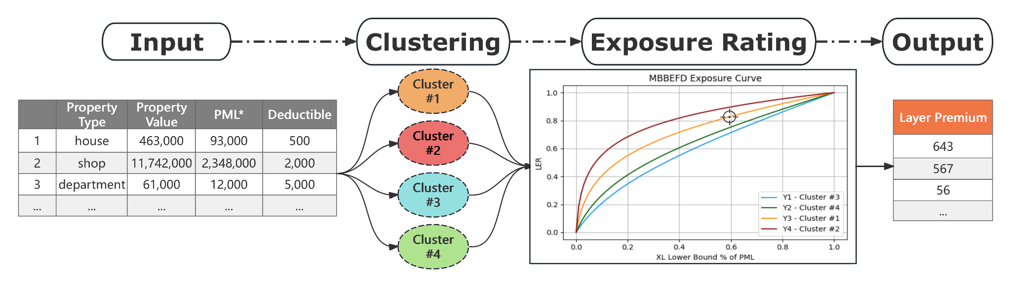
Pricing Process
*PML: Probate Maximum Loss
Let’s delve deeper…
Notes:
We use the hist data
Once the model is built, and when a new policy comes, you , as our client, only need to throw the input data into the model, and the model will automatically provide an output, the layer premium/ price.
Color of cluster → match the curve
How do you make sure your
cv of clusters → exposure curve
How do we know we made the correct match?
The 4 swiss re curves are used by non-proportional underwriter.
The whole reason why we use exposure rating: CIC doesn’t have enough claim experience, therefore we have to use swiss re curves as reference, which has been tested and validated to be good at modeling losses of risk clusters.
how do you cluster 1 is the least risky class and therefore matches y1?
CV of clusters
Risk: Deviation from the expected, parachuting with or without equipment, which has more risk?

Slide 8
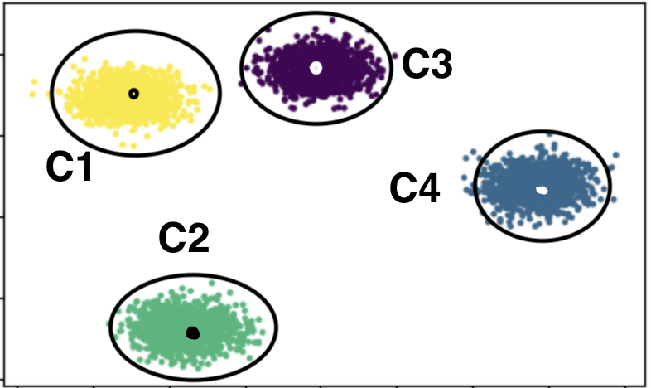
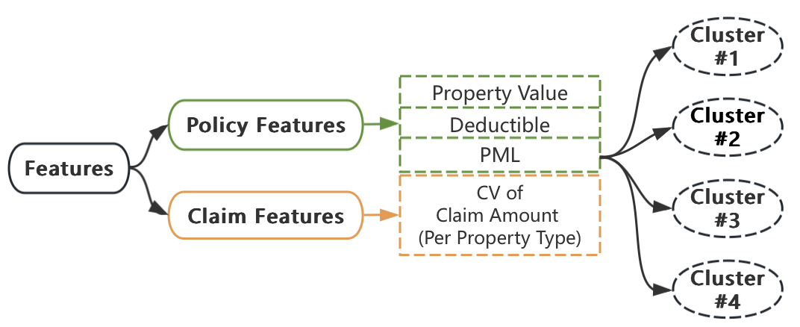
Pricing Process - Clustering: Finding Similarities
*
Initialization: Initial representatives (centroids)
Assignment
Evaluation: Within-Cluster Sum of Squared Error (WCSSE*)
Update: New centroids
Repeat: Steps 2, 3 and 4
Objective
Minimize WCSSE*
*CV: Coefficient of Variation, indicating how large the standard deviation is in relation to the mean. See Appendix - 1 for more details.
*WCSSE: Within-Cluster Sum of Squared Error, measuring the overall distance with all clusters. See Appendix - 2 for more details.
*Choice of K (i.e. number of clusters): See Appendix - 3 for more details.
Notes:
Like we saw in the midterm presentation, the exploratory analysis for the data, we have a large list of properties. We have houses, and office building, aircrafts and cars. etc.
Now, we want to organize these properties into groups/clusters, based on their similarities, especially their similarities of risk exposures/levels.
So 1st, we extracted a few features from the data, which characterize their risk levels. As ly mentioned before, These features can be divided into the policy features and claim features (according to whether the actual losses have incurred.)
And then comes our K-Mean clustering model. How does the clustering model work? it works in the following steps to group the property policies:
Initialization: select 4 random policies as the initial representatives (centroids)
Assignment: Each other policy is then assigned to the nearest centroid based on the features
Evaluation: Calculate Within-Cluster Sum of Squared Error (WCSSE) to measure the overall cohesion of clusters
Update: The centroid of each cluster is relocated as the average of the policies within the cluster
Repeat: Steps 2, 3 and 4 are repeated until the centroids stabilize and the clusters are as well-defined as possible.
So basically, the whole process is trying to minimize the WCSSE.
And just a reminder, if you are not familiar with any of those terminologies, or are interested in how we find out the best value of K (i.o.w., the number of clusters), keep a note and we’ll go into more details in the appen

Slide 9
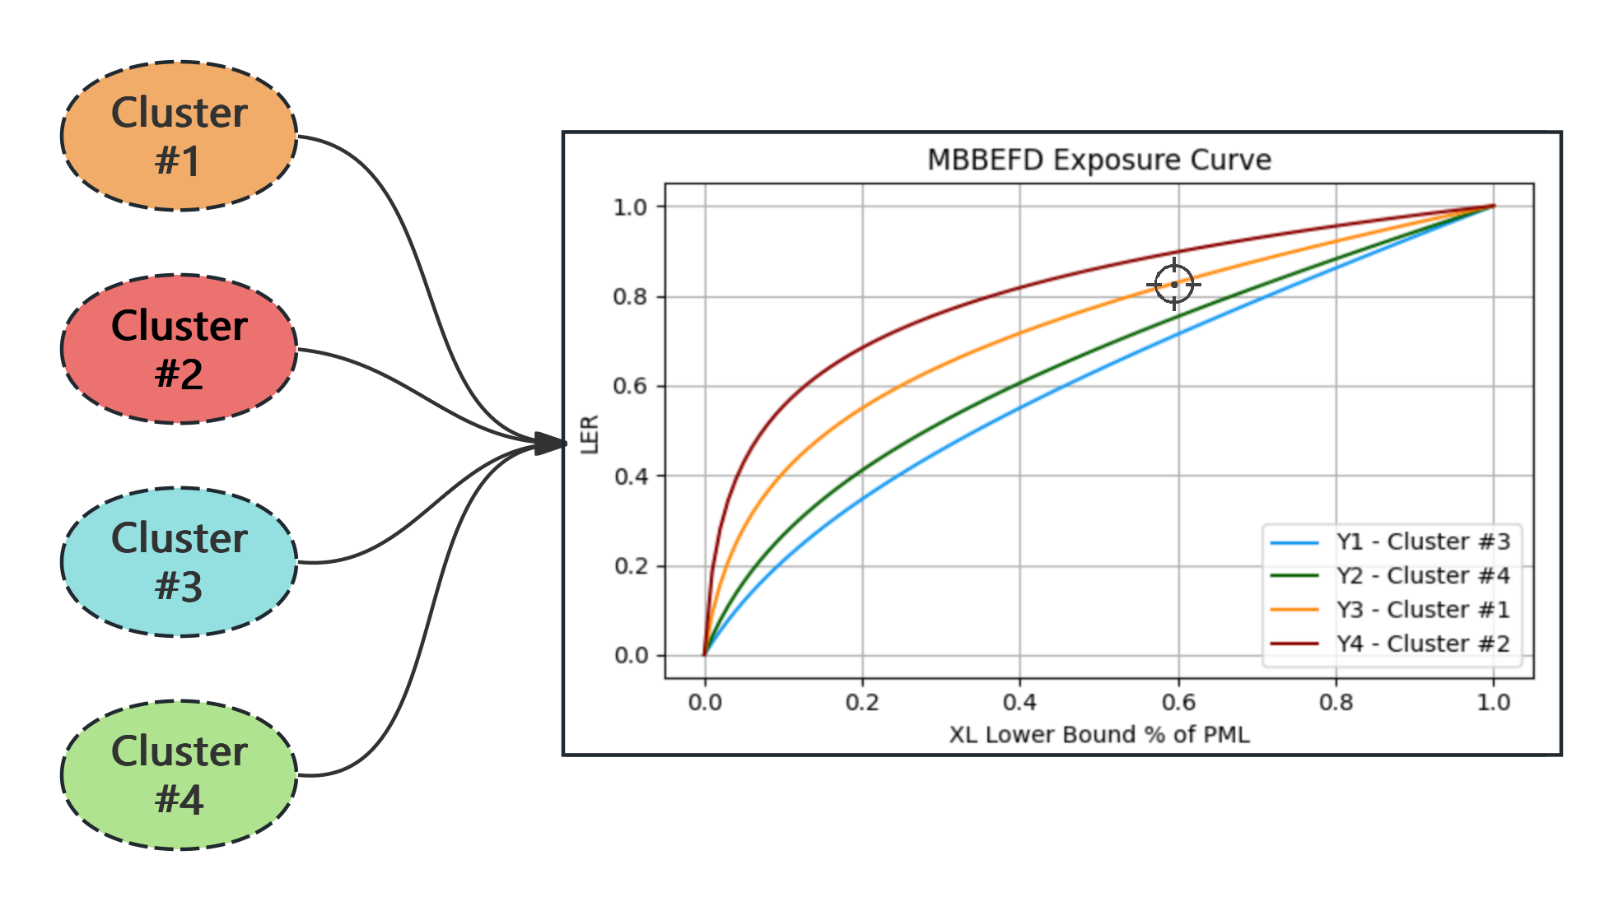
Pricing Process - Exposure Rating: Find Matches
Match the curves + Match the points → LER*
XL Lower Bound % of PML = (XL Lower Bound / PML)* Premium
*LER: Loss Elimination Ratio, i.e. the proportion of loss eliminated by deductibles.
Notes:
We are using the lower bound of the CIC’s exposure to calculate LER
Match the curves:
match the clusters to the exposure curves
Match the points:
when a new policy comes first find the cluster it belongs to, and the curve corresponding to its cluster
calculate the lower bound of its Excess of Loss, as the % of PML, which we’ll go into more details in the next slide
use that % we calculate, to find the corresponding Loss Elimination Ratio (i.e. LER), according to its curve and % deductible
Once we get the Loss Elimination Ratio for a new policy, use this formula to calculate its price as the % of premium.
Q: explain the formula:
A: LER represents the proportion of loss that is covered/eliminated by the deductible, which is paid by the policyholders. So 1-LER represents the proportion of loss premium that should be priced accordingly.

Slide 10
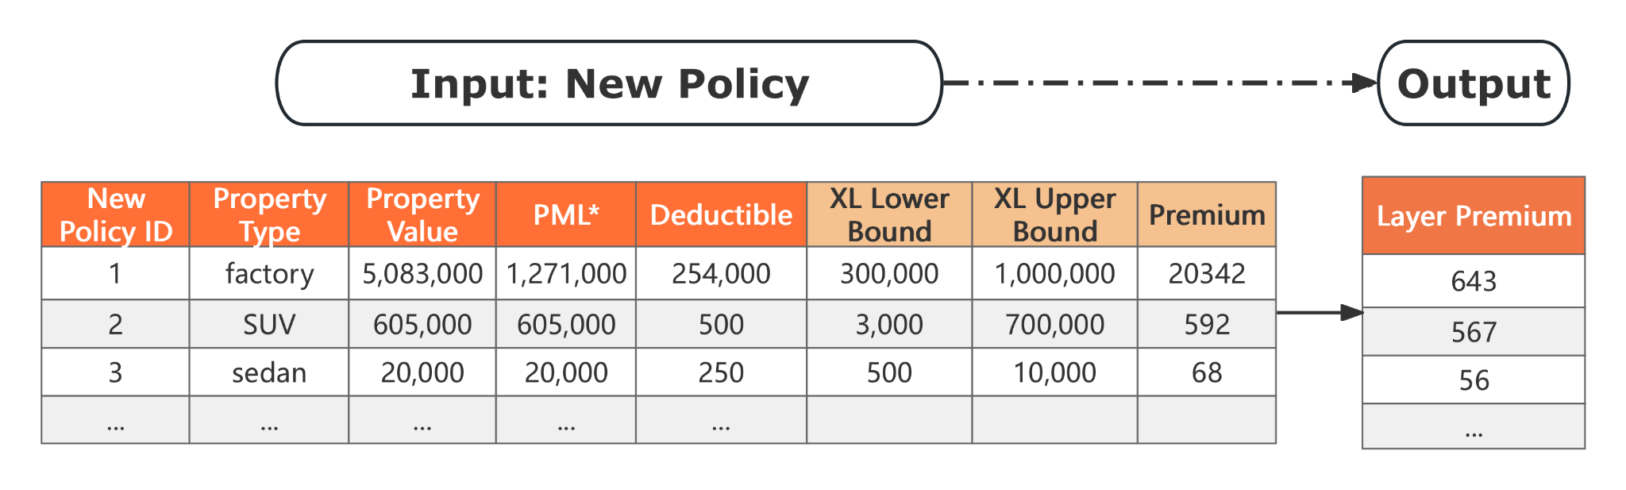
Output Overview - Example
Net Premium = (XL Upper Bound/ PML)* Premium
Layer Premium = (1 - LER) * Net Premium
*XL Lower Bound: Excess of Loss, any loss below which is eliminated by the deductible and reinsurance.
*XL Upper Bound: Excess of Loss, any loss above which is eliminated by the policy limit and reinsurance.
*Premium: The preliminary premium calculated by CIC.
Notes:
The second type of data includes the lower bound and upper bound of the excessive loss, the range of which is the CIC’s exposure that’s not covered by any risk transfer mechanism, and the preliminary premium that they calculated.
Below Lower bound: deductible, it could be reinsurance
Above upper bound: Policy limit or reinsurance
Any risk transfer mechanism: deductible, reinsurer, policy limit
current: premium < loss
How do you explain price % of Premium?
net premium = upper
The premium is whatever amount CIC wants to make cover its loss
risk premium = 1-ler
Price = risk premium * PML
Formula: why is it 1-LER(risk premium)?
A reasonable premium should at least = loss, so part of the loss is covered by the policy holder by paying the deductible, which can be represented by LER. So 1 - LER measures the proportion that CIC is exposed to.

Slide 11
Goals - Results
Goals
Methods
Results
Risk Class Definition
K-Means Clustering
4 Risks Classes
&
Clustering Model
Notes:
explain why experience rating doesn’t work, explain why we use machine learning

Slide 12
Goals - Results
Goals
Methods
Results
Pricing Strategy Based on Risk Classes
Exposure Rating
Layer Premium
Notes:
price interchangeable with premium, final premium = initial premium*
with initial premium being inputted by the client through preliminary modeling,
Price = risk premium * PML, this price covers their loss
It’s CIC’s internal decision how much to add onto the fair price
cover operation cost
meet profit margin

Slide 13
Recommendations
Auto & Aviation:
Drivers’ Age, …
Model Improvement
&
Rating Factor Analysis
More Comprehensive Data
Real Estate:
Number of Floors, Property Age, …
General:
Geographical Location, …

Slide 14
Lessons
Limitation of Low Dimensional Data
Methods of
Utilizing Data
Importance of Specialized Tools
Details of Presentation

Slide 15
Future Considerations
Model Improvement
Improve risk clustering model with more detailed data
Implement factor analysis to price more accurately
Test different machine learning models and other pricing methods
Regression model to find loss sensitive features
Market Monitoring
Environmental/Climate change
Monitor market trends
Competitor analysis
Insurance regulation and law
Notes:
Change the regression model on initial premium, maybe remove. wit for Carlos.
auto insurance: historical claim - premium, - loss
vehicle type, drivers’ age, finding out what features are significant
Social Inflation → policyholders more favorable, insurance companies more likely to lose in lawsuit.

Slide 16
Q & A
THANK YOU
Notes:
claim 20 yrs ago, adjust for inflation? the data file we got is already adjusted for inflation for 2024.
Did you explore other algorithm, why k means, because we wanted to find similarities, and k means did a good job.
How did u know u r right? What steps did u consider? → Peer reviewed,

Slide 17
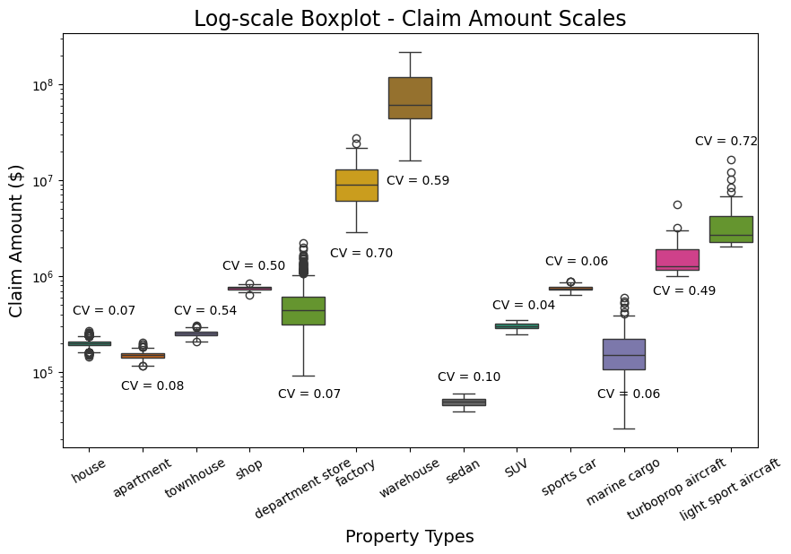
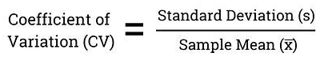
Appendix - 1 - Coefficient of Variation (CV)
Measures relative volatility level of claim amount (i.e. actual loss incurred)
The higher the CV, the more volatile a product line is.
Notes:
explain why experience rating doesn’t work, explain why we use machine learning

Slide 18
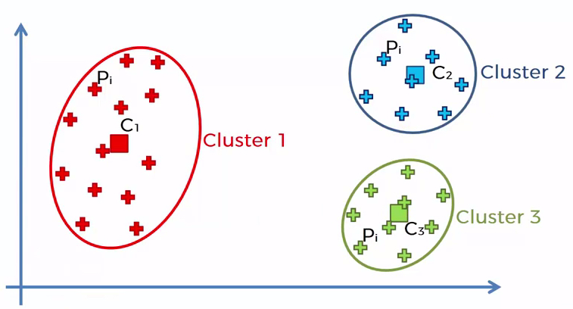
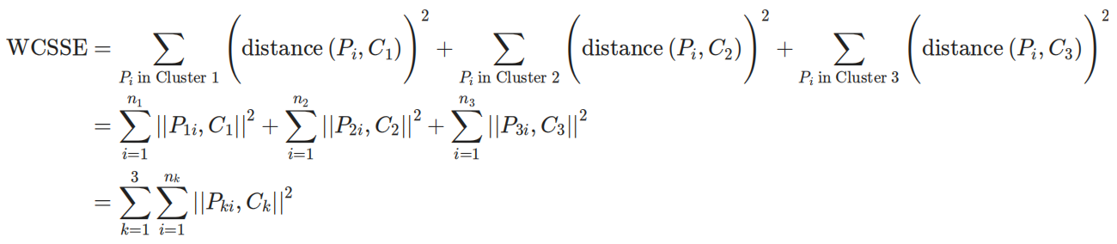
Appendix - 2 - WCSSE: A Measure Of Distance
Within-Cluster Sum of Squared Error (WCSSE), is a measure of the overall internal cohesion of clusters, which we aim to minimize.
It is calculated as follows:
(e.g. number of clusters K=3)
*

Slide 19
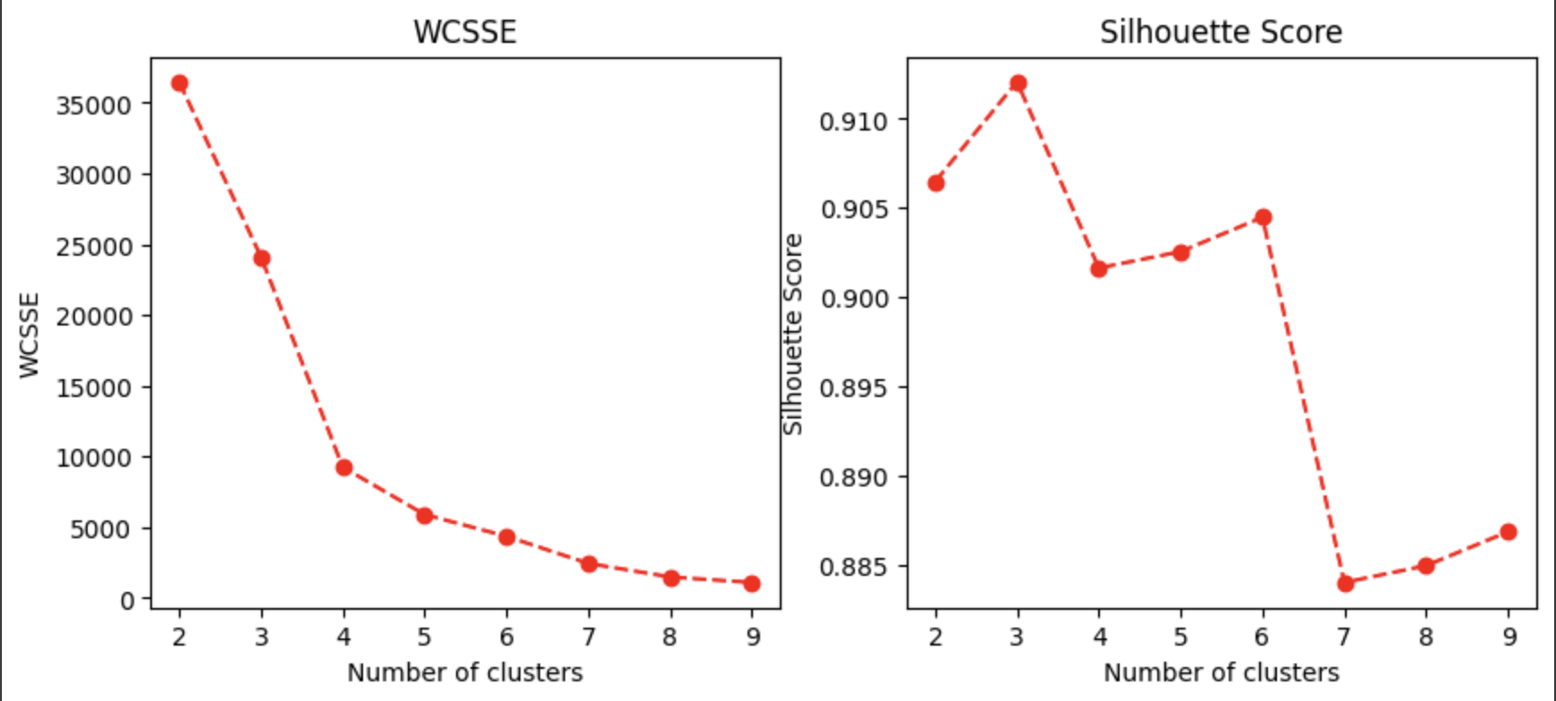
Appendix - 3 - Choice of The Optimal K
62%
1.2%
*
*Silhouse Score: The closer to 1, the further the clusters are apart from each other and clearly distinguished.
Notes:
We tried K values ranging from 2 to 10, and narrowed down the choice between K=3 or 4.
Coz our goal is to minimize the SSE and maximize the Silhouette Score.
By choosing K=4, can decrease the SSE by 62%, at the cost of only 1.2% drop in Silhouette Score, which is negligible

Slide 20
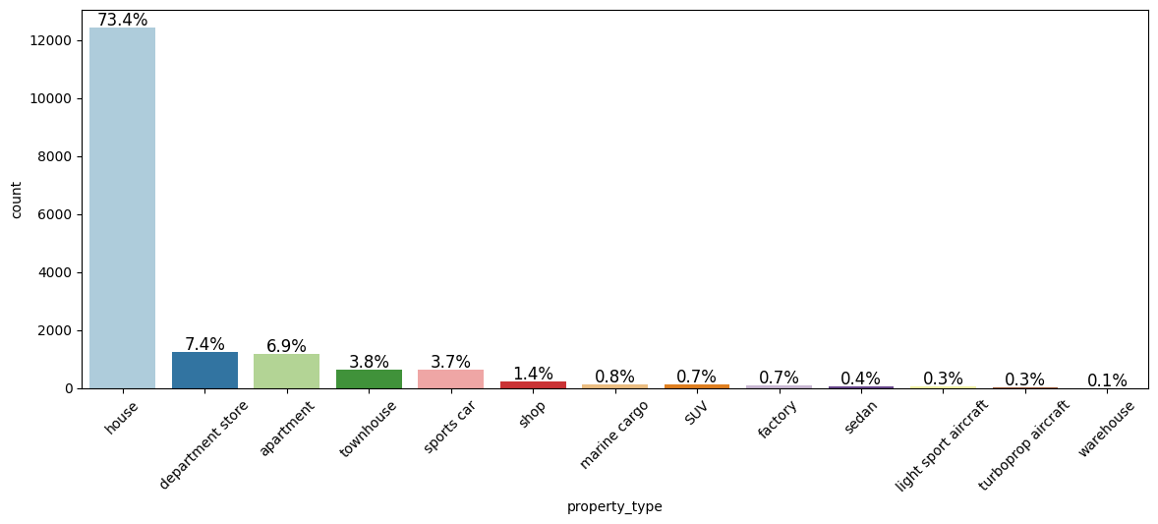
Appendix - 4 - Property Type
Notes:
Q: why use Exposure Rating

Slide 21
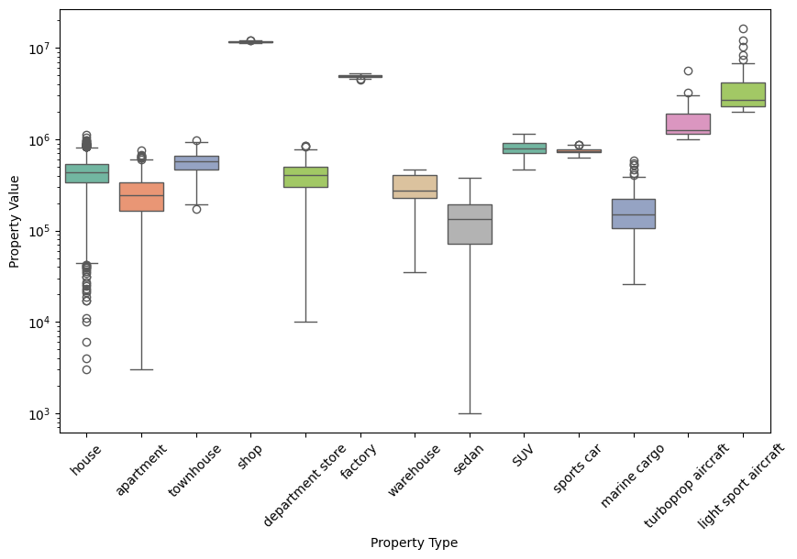
Appendix - 5 - Property Value

Slide 22
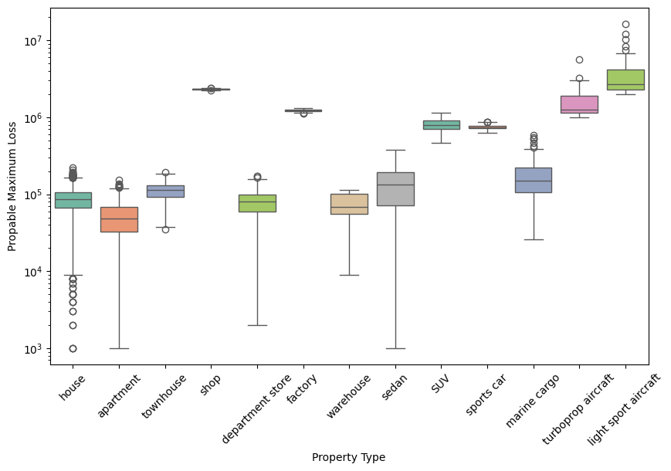
Appendix - 6 - PML
Notes:
Basic idea of classification:
Policies with similar exposure → a risk class
for the sake of completion
Q: Why these features?
It’s the only given quantitative policy profile features

Slide 23
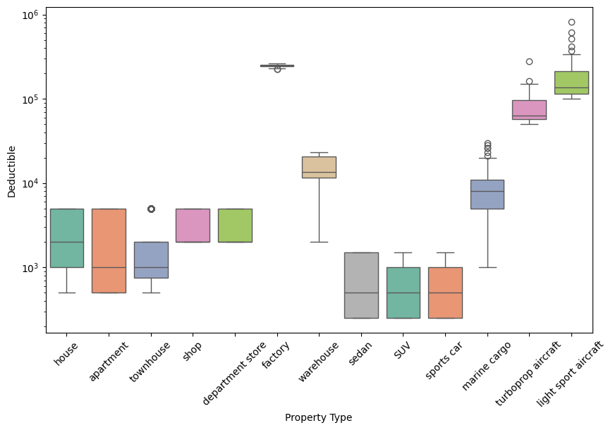
Appendix - 7 - Deductible

Slide 24
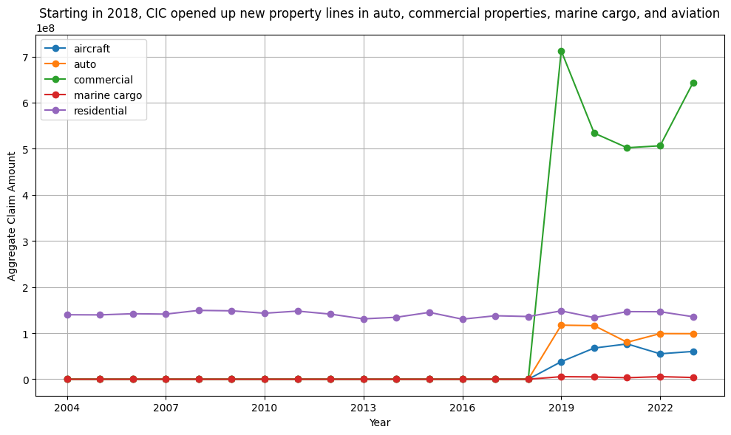
Appendix - 8 - Lack of Claim Experience
/ 100 Million
Notes:
Q: why use Exposure Rating

Slide 25
Appendix - 9 - Market Research
Marine Cargo Growth https://finance.yahoo.com/news/marine-cargo-insurance-market-set-133000167.html
Commercial Property Growth https://www.insurancebusinessmag.com/us/news/breaking-news/commercial-property-insurance-market-to-hit-us724bn-by-2032-458055.aspx#:~:text=The%20commercial%20property%20insurance%20industry,report%20from%20Allied%20Market%20Research.
Auto Growth https://straitsresearch.com/report/auto-insurance-market#:~:text=The%20global%20auto%20insurance%20market,of%20an%20accident%20or%20theft.
Aviation Growth https://finance.yahoo.com/news/aircraft-insurance-market-size-expected-143500313.html

Slide 26
Appendix - 10 - Additional Resources
Actuarial Standards of Practice https://www.actuarialstandardsboard.org/standards-of-practice/
Exposure rating
https://www.swissre.com/dam/jcr:7137dac0-83a6-4cfa-80a4-93d33c35562f/exposure-rating-brochure.pdf
Number of Years of Claim Experience Needed for Experience Ratings
https://www.ncci.com/Articles/Documents/UW_ABC_Exp_Rating.pdf
MBBEFD
https://www.casact.org/sites/default/files/2021-03/8_Bernegger.pdf
Loss sensitive features
https://www.actuaries.org.uk/system/files/documents/pdf/mata_0.pdf
Notes:
how did we use ASOP, number 23 data quality, we read that, and we took into consideration of that when handling the data, i.e. we did not share the data, and we were careful with handling the data.

